Slide 1

Object Oriented Programming Android Tutorials Tutorial #5 : Create a map class
Department of Computer Science and Information Engineering
Shuo-Han Chen (陳碩漢), shchen@csie.ntut.edu.tw
Hong-Yue Technology Research Building 1223
F 09:10 - 12:00
Notes:
Good Afternoon everyone
I am Shuo-Han Chen, a postdoctoral research fellow at Academia Sinica
It is a great honor to be invited by the department for being here today

Slide 2

Android Game Framework 使用說明
利用陣列建立遊戲地圖類別
練習5：利用陣列建立一個遊戲地圖的類別。
Notes:
Thank you for listening. Now, I would like to end today’s talk by the Q & A time.

Slide 3
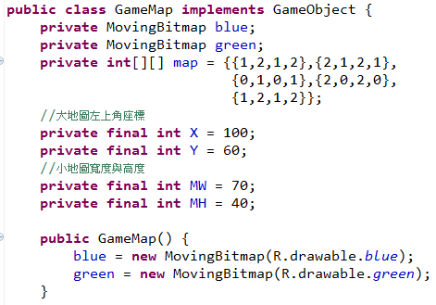
1.參考練習3，加入兩張圖片。
2.新增一個Class 名為GameMap，並且加入GameMap()

Slide 4
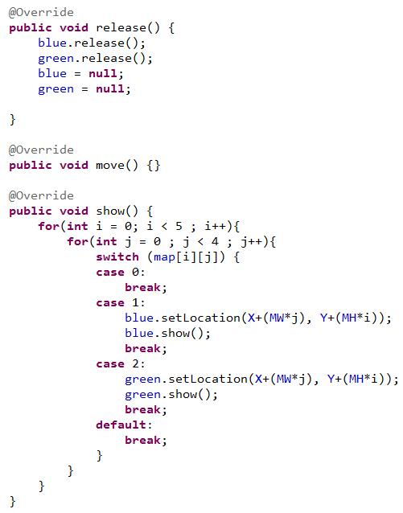
3. GameMap 再實作出GameObject 的move()、show()和release()

Slide 5
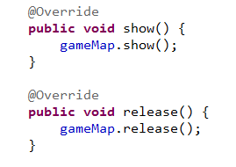
4.在StateRun.java 中宣告物件GameMap：
5.接著在release()、show()中加入物件GameMap 的副程式：
＊注意貼圖的順序，後面貼的圖會蓋住前面貼的圖。

Slide 6
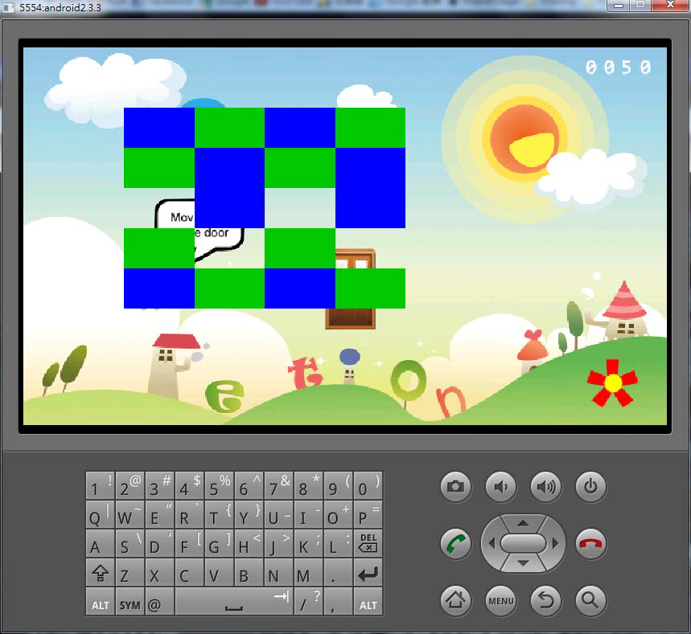
6.執行，執行結果如下(請注意畫面與陣列內容相同)。

